Slide 1

K-Means clustering for telecommunication domain
170cs3065- Big data analytics project

Slide 2
ABSTRACT
Cluster analysis is one of the major data analysis methods widely used for many practical applications in emerging areas of data mining. A good clustering method will produce high quality clusters with high intra-cluster similarity and low inter-cluster similarity.
This research work is carried out on telecommunication domain using k-Means clustering algorithm.
Telecommunication data is the source data for this analysis. The connection oriented broadband data is given as input to find the clustering quality of the algorithms.
Distance between the server locations and their connection is considered for clustering. Execution time for each algorithm is analyzed and the results are compared with existing models. Results found in comparison study are satisfactory.
Keywords— k-Means Algorithm, Data Clustering, Time Complexity, Telecommunication Data

Slide 3
INTRODUCTION
Data mining (knowledge discovery from data) ◦ Extraction of interesting (non-trivial, implicit, previously unknown and potentially useful) patterns or knowledge from huge amount of data.
Data Mining (DM) is a convenient way of extracting patterns, which represents knowledge implicitly stored in large data sets and focuses on issues relating to their feasibility, usefulness, effectiveness and scalability.
Data mining approach and its technology is used to extract the unknown pattern from the large set of data for the business and real time applications. It can be viewed as an essential step in the process of knowledge discovery.
Data mining approach and its technology is used to extract the unknown pattern from the large set of data for the business and real time applications. It can be viewed as an essential step in the process of knowledge discovery.
Started as little more than a dry extension of DM techniques, DM is now bringing important contributions in crucial fields of investigations.

Slide 4
Data mining can be performed on various types of databases and information repositories, but the kind of patterns to be found are specified by various data mining functionalities like class/concept description, association, correlation analysis, classification, prediction, cluster analysis etc.
Among these, Cluster analysis is one of the major data analysis method widely used for many practical applications in emerging areas
Clustering is the process of finding groups of objects such that the objects in a group will be similar (or related) to one another and different from (or unrelated to) the objects in other groups.
The quality of a clustering result depends on both the similarity measure used by the method and its implementation and also by its ability to discover some or all of the hidden patterns.
Different clustering approaches may yield different results.
This research work compares two of the partitioning based clustering techniques namely k-Means and k-Medoids via its performance based on their execution time.

Slide 5
PROPOSED SYSTEM
An Enhanced k-means algorithm to improve the Efficiency Using Normal Distribution Data Points is discussed by Napoleon and Ganga Lakshmi in their research work.
This paper proposes a method for making the k-means algorithm more effective and efficient; so as to get better clustering with reduced complexity.
In this research, the most representative algorithms k-Means and the Enhanced kMeans were examined and analyzed based on their basic approach.
They found that the elapsed time taken by proposed enhanced k-means is less than k-means algorithm.
A work carried out by Benderskaya et al., titled as “Self-organized Clustering and Classification: A Unified Approach via Distributed Chaotic Computing” describes a unified approach to solve clustering and classification problems by means of oscillatory neural networks with chaotic dynamics.
The advantages of distributed clusters formation in comparison to centers of clusters estimation are demonstrated. New approach to clustering on-the-fly is proposed.

Slide 6
Modules Description
There are few common steps involved in implementing the algorithms as :-
Data Collection: The data we have Gathered from the telecommunication center to analyze the telecom data.
Data Preprocessing: It involves removing the outliers of the data, Eliminating the unnecessary data.
Data Transformation: It is the process of converting data from one format or structure into another format or structure.
Applying Algorithms: It involves the application of the data mining algorithms to the given dataset.
• Predicting the data: It is the practice of extracting information from existing data sets in order to determine patterns and predict future outcomes and trends.

Slide 7
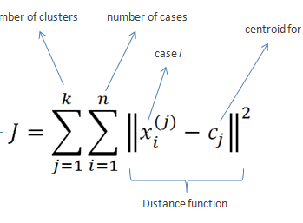
DESIGN & IMPLEMENTATION
ALGORITHMS:
The k-Means is one of the simplest unsupervised learning algorithms that solve the well known clustering problem. The procedure follows a simple and easy way to classify a given data set through a certain number of clusters (assume k clusters) fixed a priori . This algorithm aims at minimizing an objective function, in this case a squared error function. The objective function is as follows:

Slide 8
The algorithm is composed of the following steps:
Step 1: Place k points into the space represented by the objects that are being clustered. These points represent initial group centroids.
Step 2: Assign each object to the group that has the closest centroid.
Step 3: When all objects have been assigned, recalculate the positions of the k centroids.
Step 4: Repeat Steps 2 and 3 until the centroids no longer move.
This produces a separation of the objects into groups from which the metric to be minimized can be calculated. Although it can be proved that the procedure will always terminate, the k-Means algorithm does not necessarily find the most optimal configuration, corresponding to the global objective function minimum .
This k-Means is a simple algorithm that has been adapted to many problem domains .

Slide 9
PSEUDOCODE
library(tidyverse)
library(MASS)
library(car)
library(e1071)
library(caret)
library(cowplot)
library(caTools)
library(pROC)
library(ggcorrplot)
telco <- read.csv("../input/WA_Fn-UseC_-Telco-Customer-Churn.csv")
glimpse(telco)
telco <- telco[complete.cases(telco),]

Slide 10
telco$SeniorCitizen <- as.factor(ifelse(telco$SeniorCitizen==1, 'YES', ‘NO’))
options(repr.plot.width =6, repr.plot.height = 2)
ggplot(telco, aes(y= tenure, x = "", fill = Churn)) + geom_boxplot()+ theme_bw()+ xlab(" ")
ggplot(telco, aes(y= MonthlyCharges, x = "", fill = Churn)) + geom_boxplot()+ theme_bw()+ xlab(" ")
ggplot(telco, aes(y= TotalCharges, x = "", fill = Churn)) + geom_boxplot()+ theme_bw()+ xlab(" ")
options(repr.plot.width =4, repr.plot.height = 4)
boxplot(telco$tenure)$out
boxplot(telco$MonthlyCharges)$out
boxplot(telco$TotalCharges)$out
telco <- data.frame(lapply(telco, function(x) { gsub("No internet service", "No", x)}))
telco <- data.frame(lapply(telco, function(x) { gsub("No phone service", "No", x)}))

Slide 11
num_columns <- c("tenure", "MonthlyCharges", "TotalCharges")
telco[num_columns] <- sapply(telco[num_columns], as.numeric)
telco_int <- telco[,c("tenure", "MonthlyCharges", "TotalCharges")]
telco_int <- data.frame(scale(telco_int))
telco <- mutate(telco, tenure_bin = tenure)
telco$tenure_bin[telco$tenure_bin >=0 & telco$tenure_bin <= 12] <- '0-1 year' telco$tenure_bin[telco$tenure_bin > 12 & telco$tenure_bin <= 24] <- '1-2 years’
telco$tenure_bin[telco$tenure_bin > 24 & telco$tenure_bin <= 36] <- '2-3 years' telco$tenure_bin[telco$tenure_bin > 36 & telco$tenure_bin <= 48] <- '3-4 years' telco$tenure_bin[telco$tenure_bin > 48 & telco$tenure_bin <= 60] <- '4-5 years' telco$tenure_bin[telco$tenure_bin > 60 & telco$tenure_bin <= 72] <- '5-6 years’
telco$tenure_bin <- as.factor(telco$tenure_bin)
options(repr.plot.width =6, repr.plot.height = 3)
ggplot(telco, aes(tenure_bin, fill = tenure_bin)) + geom_bar()+ theme1
telco_cat <- telco[,-c(1,6,19,20)]
#Creating Dummy Variables
dummy<- data.frame(sapply(telco_cat,function(x) data.frame(model.matrix(~x-1,data =telco_cat))[,- 1]))
head(dummy)
#Combining the data
telco_final <- cbind(telco_int,dummy)
head(telco_final)

Slide 12
#Splitting the data
set.seed(123)
indices = sample.split(telco_final$Churn, SplitRatio = 0.7)
train = telco_final[indices,]
validation = telco_final[!(indices),]
model_1 = kmeans(telco_final,centers=2, iter.max = 25, nstart=100)
summary(model_1)
model_1$cluster <- as.factor(model_1$cluster)
ggplot(telco, aes(tenure, TotalCharges, color = telco$cluster)) + geom_point()
pred <- model_1$betweenss/model_1$totss*100
pred

Slide 13
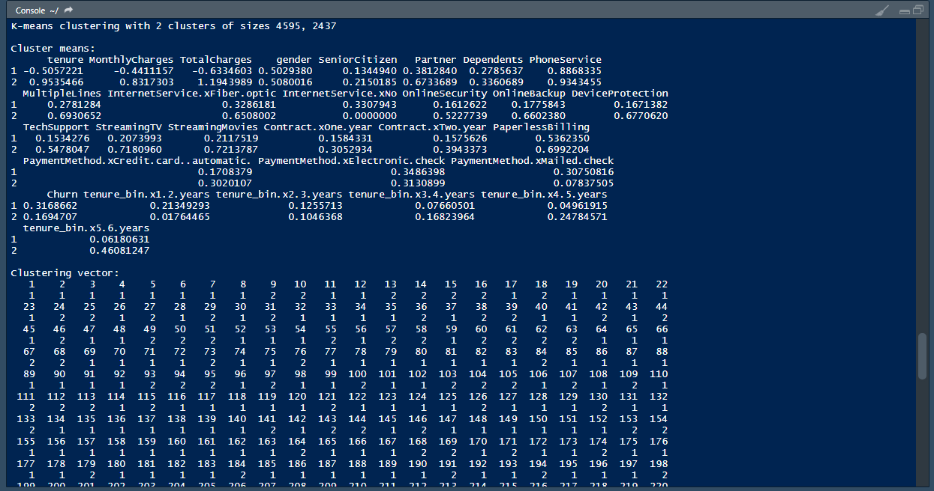
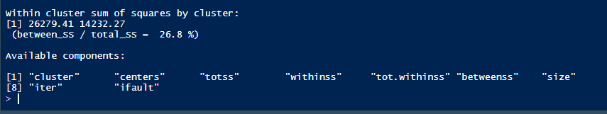
Results analysis:

Slide 14
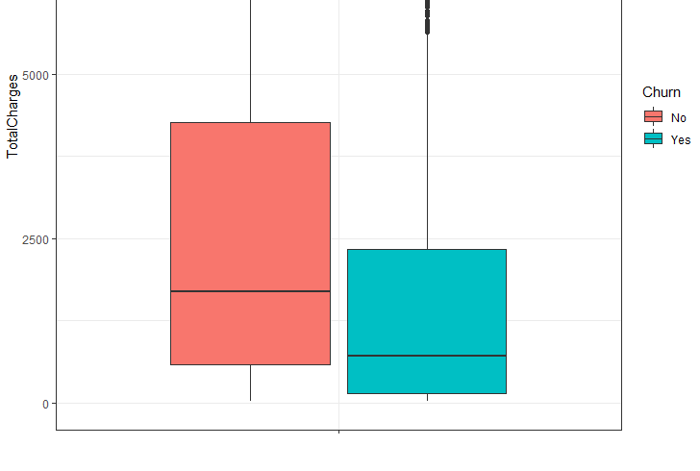
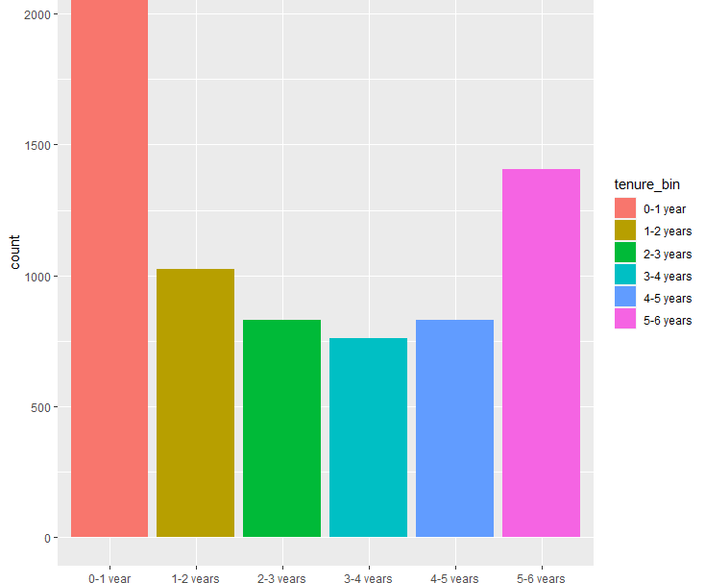
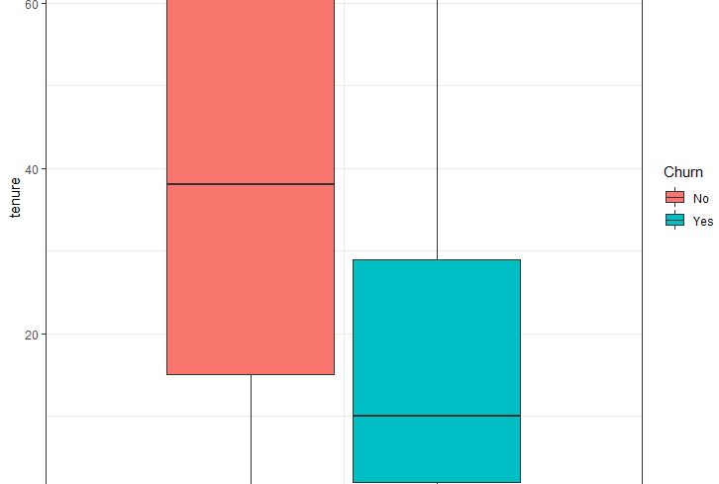

Slide 15
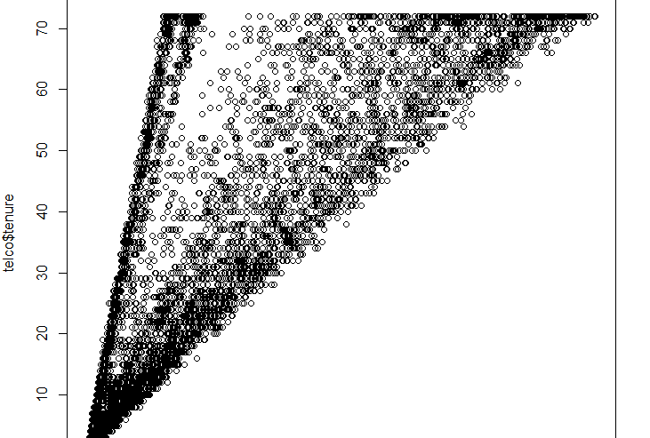
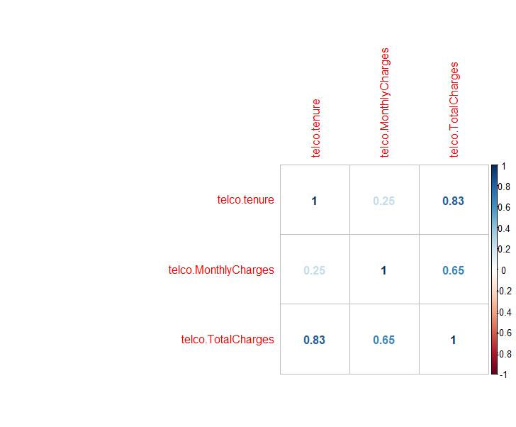
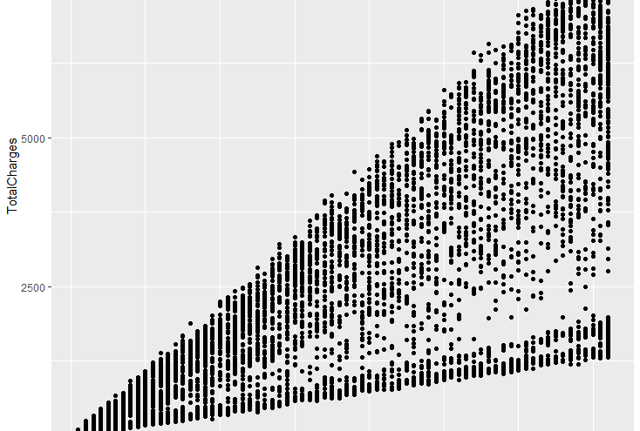

Slide 16
conclusion
Cluster analysis is still an active field of development. Many cluster analysis techniques do not have a strong formal basis.
In summary, clustering is an interesting, useful, and challenging problem. It has great potential in applications like object recognition, image segmentation, and information filtering and retrieval.
From the experimental approach, by several executions of the program, proposed algorithms in this research work, following results were obtained.
The advantage of the k-Means algorithm is its favorable execution time. Its drawback is that the user has to know in advance how many clusters are searched for.

Slide 17

Thank You
Submitted by –
G.G.Krishna vamsi
170030383
BDA (S-4)

